Slide 1
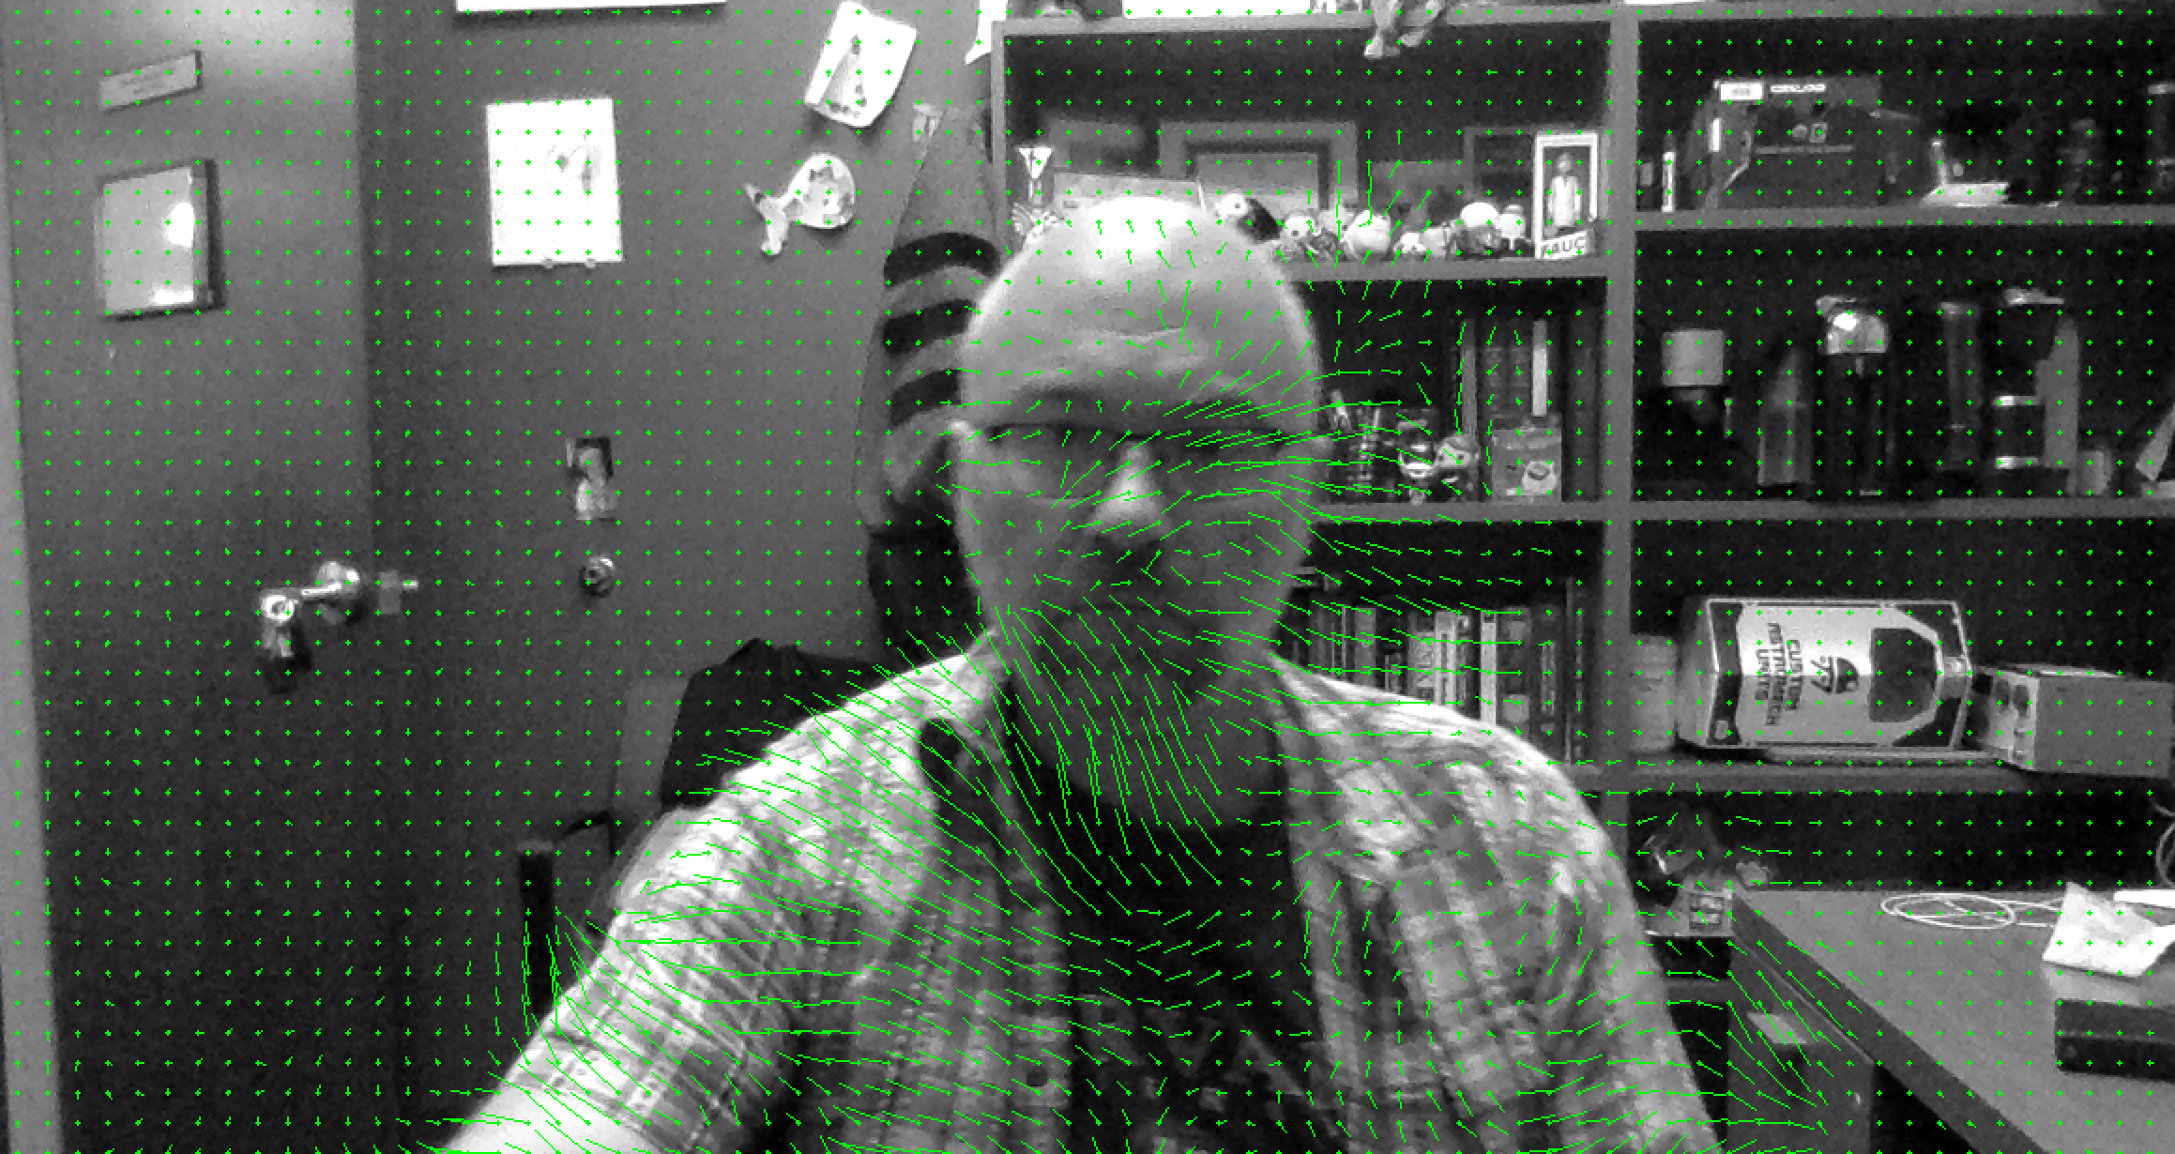
Lecture 17 Object Tracking
ECE 1390/2390

Slide 2
Project Updates (10/30 & 11/4)
What do I expect?
Progress update
10min informal presentation
Can use your own laptop or give me slides
Show off what you have done so far
Have you tried things that didn’t work?
What class lessons have you incorporated into the project? Any insights?
Have your objectives changed?
Has there been any unanticipated issues?
10/30
BokehSwap
DC not DC
AutonomousDriving
RepVision
FaceEmojiSwap
11/4
Team Sebastian, Timothy, Jake, & Tyler
Shopkeepr
The Riddlers
Touchfree

Slide 3
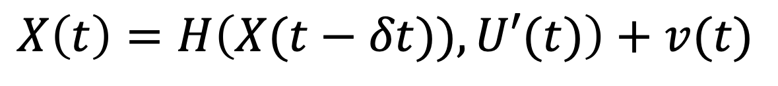
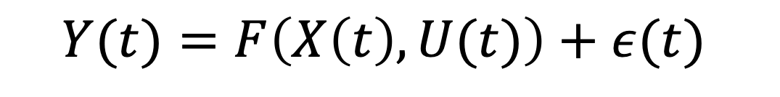
Kalman Filter
Model (e.g. physics) based tracking
Measurement noise
Measurement (Lead field) model
Observation layer
Observations
$$Y(t)=F\left(X\left(t\right),U(t)\right)+ε(t)$$
Control/Input vector [optional]
State/process noise
Hidden-state layer
States
$$X\left(t\right)=H\left(X(t−δt)),U′(t)\right)+v(t)$$
State update model

Slide 4
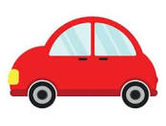

Example
Observation Layer
$\left[\begin{matrix}Y_{lat}[n] \\ Y_{long}[n]\end{matrix}\right]$= $\left[\begin{matrix}X_{lat}[n] \\ X_{long}[n]\end{matrix}\right]+ε$
Position Layer
$\left[\begin{matrix}X_{lat}[n] \\ X_{long}[n]\end{matrix}\right]=\left[\begin{matrix}X_{lat}[n−1] \\ X_{long}[n−1]\end{matrix}\right]$+$T∙\left[\begin{matrix}cos⁡(θ\left[n\right]) & sin⁡(θ\left[n\right]) \\ −sin⁡(θ\left[n\right]) & cos⁡(θ\left[n\right])\end{matrix}\right]∙V_{elocity}\left[n\right]+p$
Velocity Layer
$\left[\begin{matrix}V_{elocity}\left[n\right] \\ θ[n]\end{matrix}\right]=\left[\begin{matrix}V_{elocity} [n−1] \\ θ[n−1]\end{matrix}\right]$+ $T∙ \left[\begin{matrix}A_{cc}[n] \\ W_{acc}[n]\end{matrix}\right]+v$
Acceleration Layer
$$\left[\begin{matrix}A_{cc}[n] \\ W_{acc}[n]\end{matrix}\right]=\left[\begin{matrix}A_{cc}[n−1] \\ W_{acc}[n−1]\end{matrix}\right]+ω$$

Slide 5
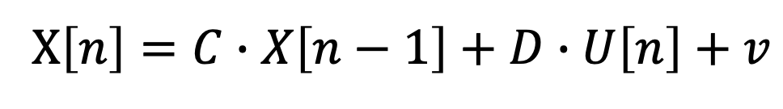
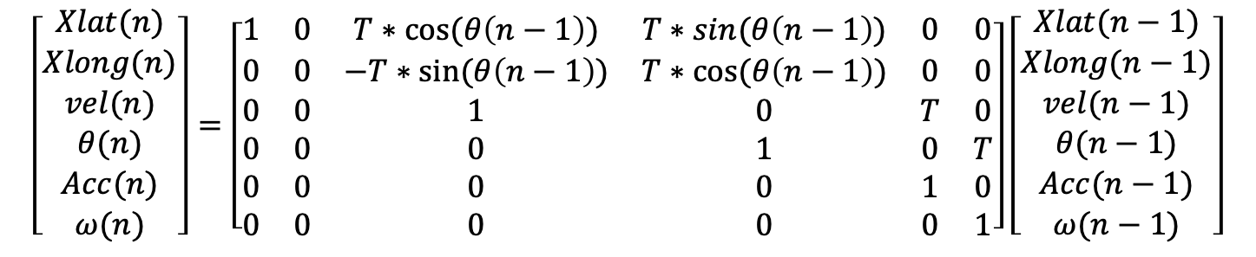
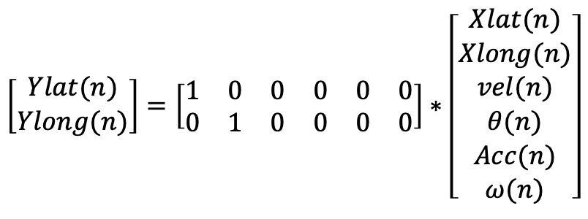
Example
$$Y\left[n\right]=A∙X\left[n\right]+B∙U\left[n\right]+e$$
$$\left[\begin{matrix}Ylat(n) \\ Ylong(n)\end{matrix}\right]=\left[\begin{matrix}1 & 0 & 0 & 0 & 0 & 0 \\ 0 & 1 & 0 & 0 & 0 & 0\end{matrix}\right]∗\left[\begin{matrix}Xlat(n) \\ Xlong(n) \\ vel(n) \\ θ(n) \\ Acc(n) \\ ω(n)\end{matrix}\right]$$
X$\left[n\right]=C∙X\left[n−1\right]+D∙U\left[n\right]+v$
$$\left[\begin{matrix}Xlat(n) \\ Xlong(n) \\ vel(n) \\ θ(n) \\ Acc(n) \\ ω(n)\end{matrix}\right]=\left[\begin{matrix}1 & 0 & T∗cos⁡(θ\left(n−1\right)) & T∗sin⁡(θ\left(n−1\right)) & 0 & 0 \\ 0 & 0 & −T∗sin⁡(θ\left(n−1\right)) & T∗cos⁡(θ\left(n−1\right)) & 0 & 0 \\ 0 & 0 & 1 & 0 & T & 0 \\ 0 & 0 & 0 & 1 & 0 & T \\ 0 & 0 & 0 & 0 & 1 & 0 \\ 0 & 0 & 0 & 0 & 0 & 1\end{matrix}\right]\left[\begin{matrix}Xlat(n−1) \\ Xlong(n−1) \\ vel(n−1) \\ θ(n−1) \\ Acc(n−1) \\ ω(n−1)\end{matrix}\right]$$

Slide 6
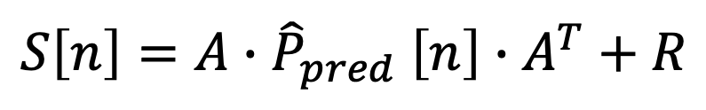
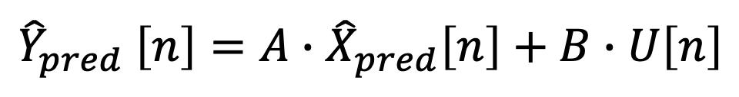
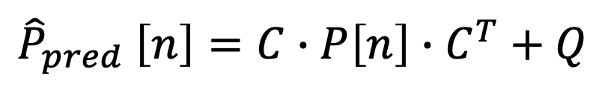
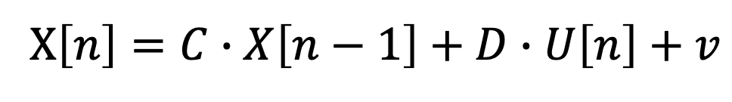
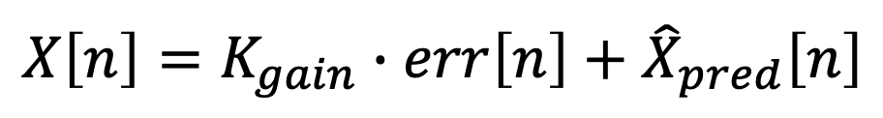
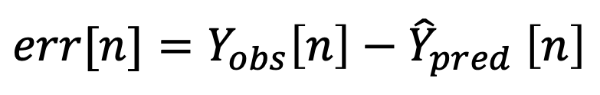
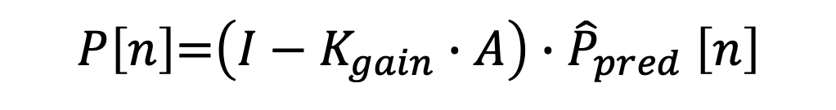
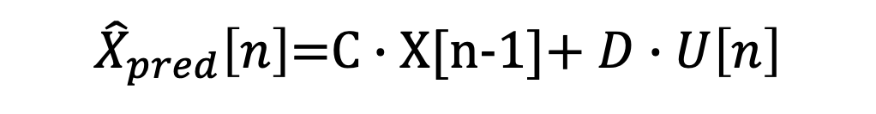
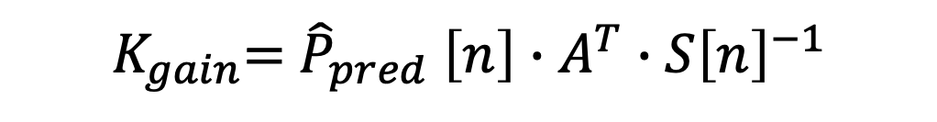
$$Y\left[n\right]=A∙X\left[n\right]+B∙U\left[n\right]+e$$
X$\left[n\right]=C∙X\left[n−1\right]+D∙U\left[n\right]+v$
${\hat{X}}_{pred}\left[n\right]$=C $∙$X[n-1]+ $D∙U\left[n\right]$
$${\hat{Y}}_{pred} \left[n\right]=A∙{\hat{X}}_{pred}\left[n\right]+B∙U\left[n\right]$$
Prediction
$${\hat{P}}_{pred} \left[n\right]=C∙P\left[n\right]∙C^{T}+Q$$
$$err[n]={Y_{obs}\left[n\right]−\hat{Y}}_{pred} \left[n\right]$$
$$S\left[n\right]={A∙\hat{P}}_{pred} \left[n\right]∙A^{T}+R$$
Update
$K_{gain}$= ${\hat{P}}_{pred} \left[n\right]∙{A^{T}∙S\left[n\right]}^{−1}$
$$X\left[n\right]=K_{gain}∙err\left[n\right]+{\hat{X}}_{pred}\left[n\right]$$
Correction
$P\left[n\right]$=$\left(I−K_{gain}∙A\right)∙{\hat{P}}_{pred} \left[n\right]$

Slide 7
>> A=eye(2);
>> nk=1000;
>> xtrue = [[1:nk]./200.*sin([1:nk]/50);...
[1:nk]./200.*cos([1:nk]/50)];
>> y=A*xtrue+randn(2,nk)/3;
R=.1*eye(2);
Q=.2*eye(2);
x=zeros(2,nk);
P=eye(2);
for k=2:nk
xhat=C*x(:,k-1);
yhat = A*xhat;
Phat = C*P*C'+Q;
err = y(:,k)-yhat;
S = A*Phat*A'+R;
K = Phat*A'*inv(S);
x(:,k)=xhat+K*err;
P=(eye(2)-K*A)*Phat;
end

Slide 8
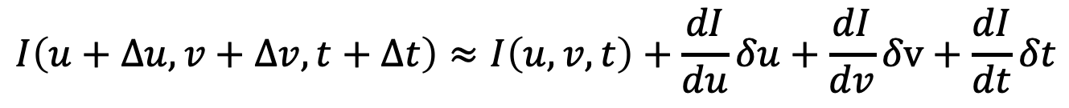
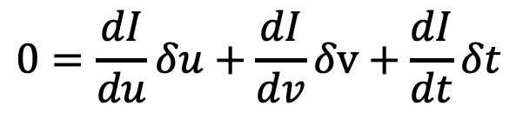
Optical Flow
$$I\left(u,v,t\right)→I\left(u+∆u,v+∆v,t+∆t\right)$$
Taylor expansion
$$I\left(u+∆u,v+∆v,t+∆t\right)≈I\left(u,v,t\right)+\frac{dI}{du}δu+\frac{dI}{dv}δv+\frac{dI}{dt}δt$$
Assume that intensity doesn’t change (just moves around)
$$I\left(u,v,t\right)=I\left(u+∆u,v+∆v,t+∆t\right)$$
$$0=\frac{dI}{du}δu+\frac{dI}{dv}δv+\frac{dI}{dt}δt$$

Slide 9
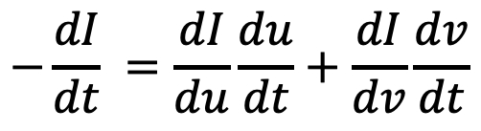
Optical Flow
Unknowns (du/dt & dv/dt)
$$−\frac{dI}{dt} =\frac{dI}{du}\frac{du}{dt}+\frac{dI}{dv}\frac{dv}{dt}$$
Change in intensity at pixel
Gradient in horizontal (u)
Gradient in vertical (v)
Each pixel has one equation and two unknowns
Lucas-Kanade Method (Sparse flow)
Gunnar Farneback Method (dense flow)

Slide 10
Optical Flow
Lucas-Kanade Method (Sparse flow)
Track only corner points
Find Shi-Tomasi points between frames (cv2.goodPointsToTrack(.) )
# params for corner detection
feature_params = dict( maxCorners = 100, qualityLevel = 0.3, minDistance = 7, blockSize = 7 )
# Parameters for lucas kanade optical flow
lk_params = dict( winSize = (15, 15), maxLevel = 2, criteria = (cv2.TERM_CRITERIA_EPS |cv2.TERM_CRITERIA_COUNT,10, 0.03))
old_pts = cv2.goodFeaturesToTrack(old_gray, mask = None, **feature_params)
New_pts, status, err = cv2.calcOpticalFlowPyrLK(old_gray, new_gray, old_pts, None, **lk_params)
# Select good points
good_new = new_pts[status == 1]
good_old = old_pts[status == 1]

Slide 11
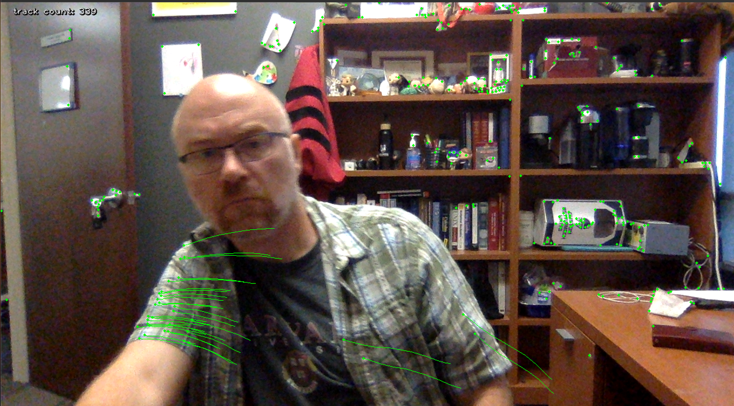
Optical Flow
Lucas-Kanade Method (Sparse flow)

Slide 12
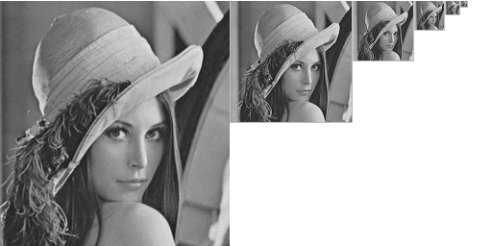
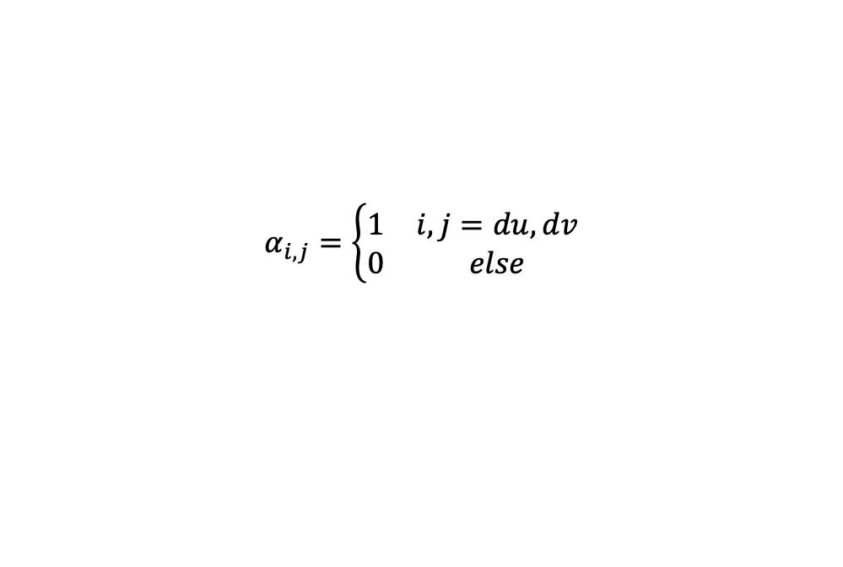
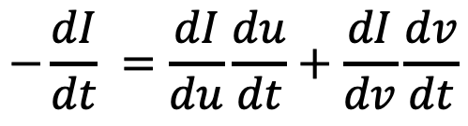
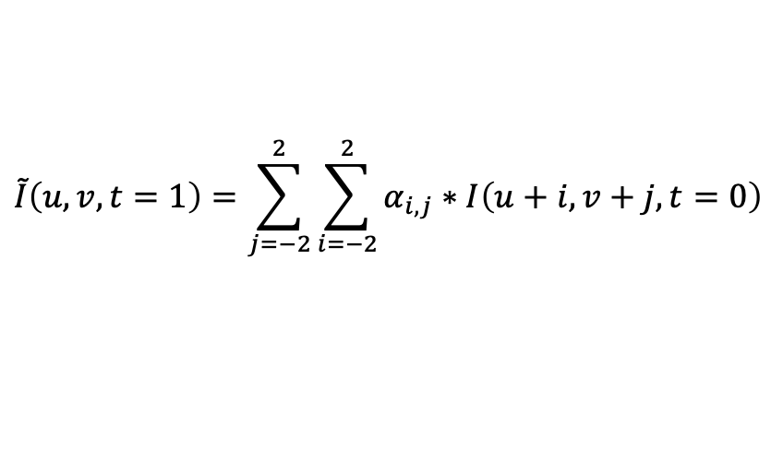
Optical Flow
$$−\frac{dI}{dt} =\frac{dI}{du}\frac{du}{dt}+\frac{dI}{dv}\frac{dv}{dt}$$
Gunnar Farneback Method (dense flow)
Make image pyramid
Polynomial Approximation
$$\tilde{I}\left(u,v,t=1\right)=\sum_{j=−2}^{2}{\sum_{i=−2}^{2}{α_{i,j}∗I\left(u+i,v+j,t=0\right)}}$$
Small movements
Larger movements →
Iterative estimate du & dv
$I\left(u,v,t=0\right)−I\left(u,v,t=1\right)=\frac{d\tilde{I}\left(u,v\right)}{du}\frac{du}{dt}+$ $\frac{d\tilde{I}\left(u,v\right)}{dv}\frac{dv}{dt}$
$$α_{i,j}=\left\{\begin{matrix}1 & i,j=du,dv \\ 0 & else\end{matrix}\right.$$

Slide 13
Optical Flow
Gunnar Farneback Method (dense flow)
flow = cv2.calcOpticalFlowFarneback(old_gray_img, new_gray_img,
flow=None,
pyr_scale=0.5, # Scale for image pyramid (0.5 -> halves image for each level)
levels=3, # number of levels in the pyramid
winsize=15,# larger the window, the less sensitive to noise, but the more blurred
iterations=3,
poly_n=5, # Number of neighbors to build polynomial expansion (usually 5 or 7)
poly_sigma=1.1). # smoothness of polynomial (usually 1.1 for poly=5 & 1.5 for poly 7)
Flow is a <n x m x 2> image and is the du/dt and dv/dt for each pixel location

Slide 14
Optical Flow
Gunnar Farneback Method (dense flow)

Slide 15
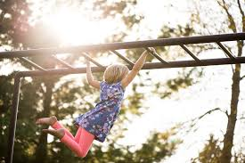
Single Object tracking
MeanShift
Center of mass of intensities inside circle
Center of mass of intensities inside (larger) circle
Size of region-of-interest in current and next frame are fixed

Slide 16
Single Object tracking
CAMShift method (continuous adaptive mean shift)
Center of mass of intensities inside circle
Center of mass of intensities inside (larger) circle
Size of region-of-interest is also adjusted based on covariance of intensities

Slide 17
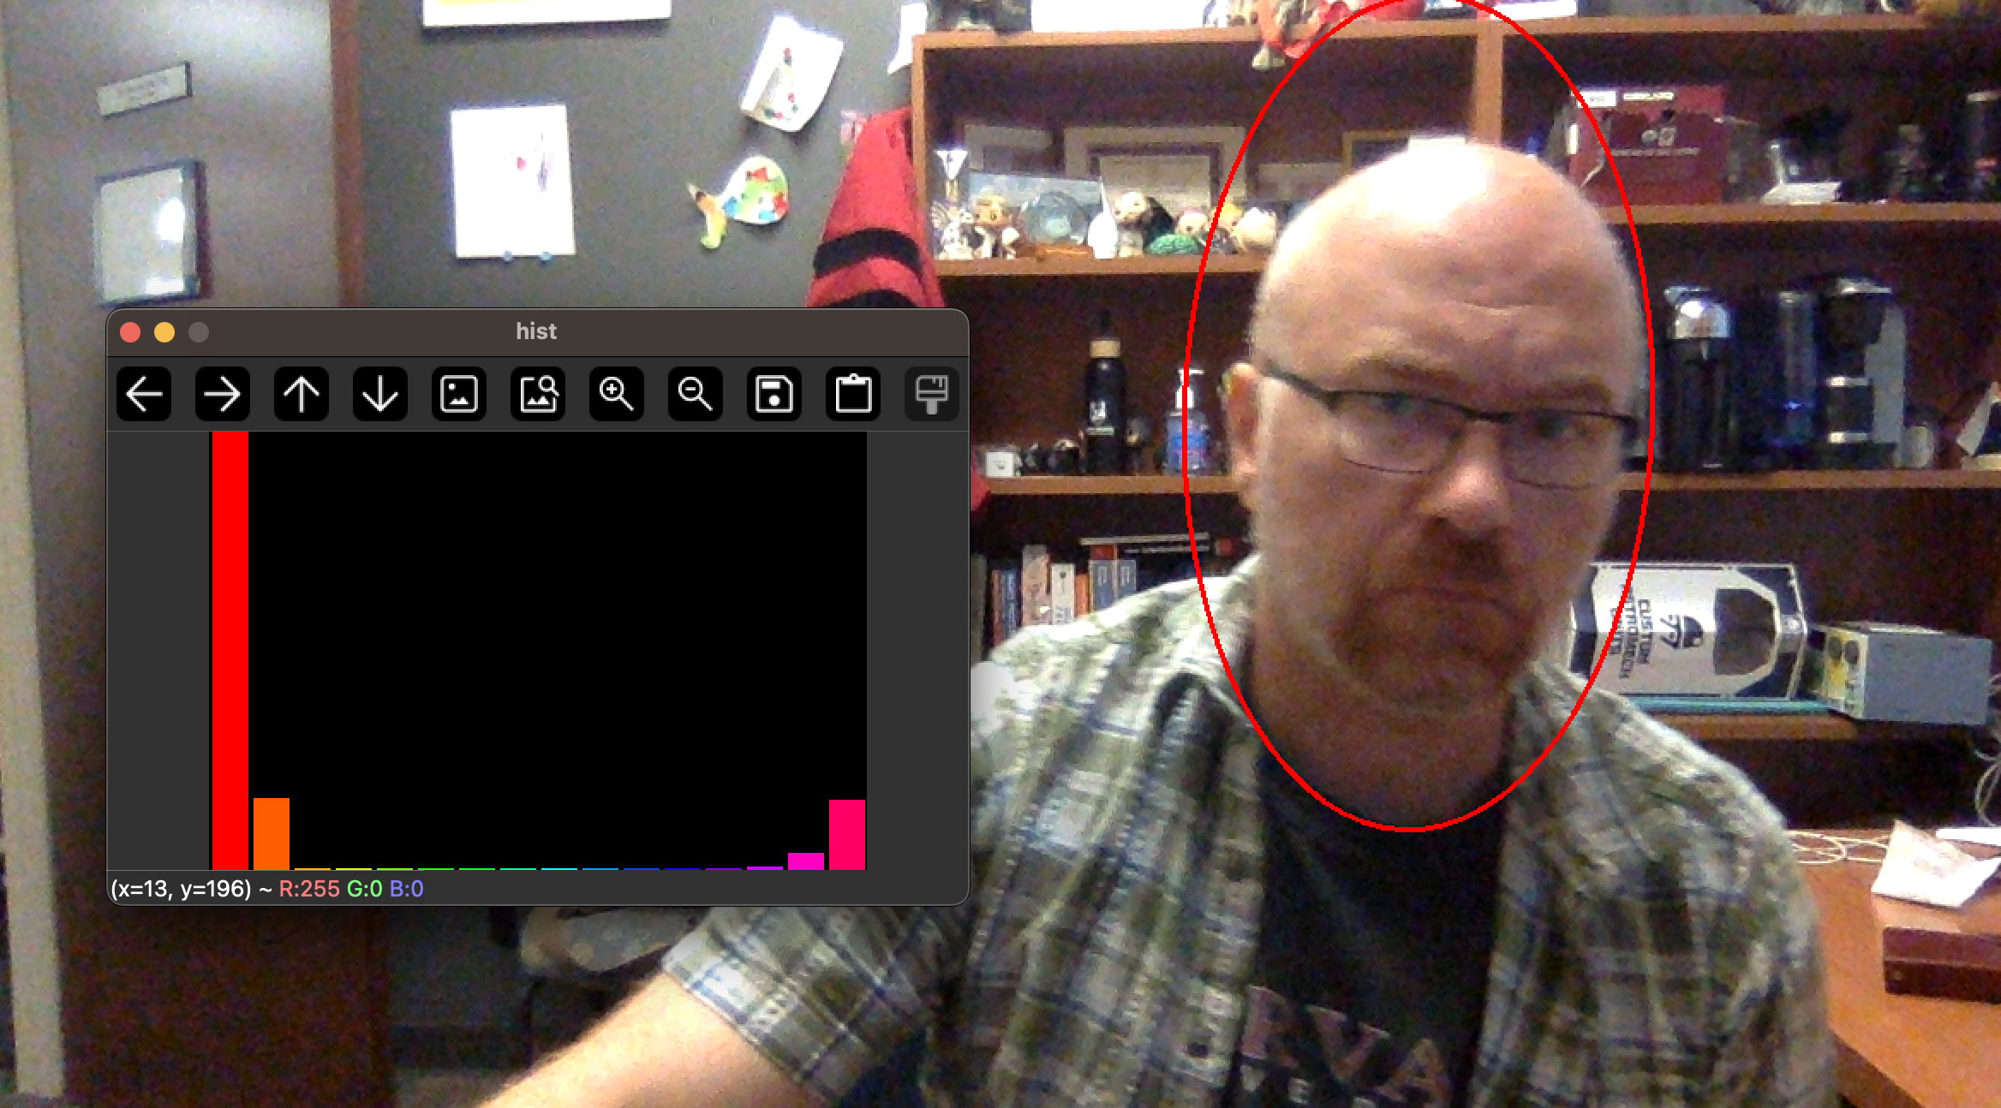
Single Object tracking
CAMShift method (continuous adaptive mean shift)

Slide 18
Boosting tracker
Similar to Haar cascade model
Requires training at runtime with positive/negative data
User labels object to be tracked (or by some detection method)
Given new frame, run classifier on all nearby pixels to previous known location
Update positives/negatives and training as we add frames

Slide 19
MIL (multiple instance learning)
Similar to Boosting tracker, but uses multiple samples around the point to define positive “bags” (collections of images related to the positive image)
Less prone to drift cf Boosting
Better job at partial occlusions than Boost but cannot track over full occlusions

Slide 20
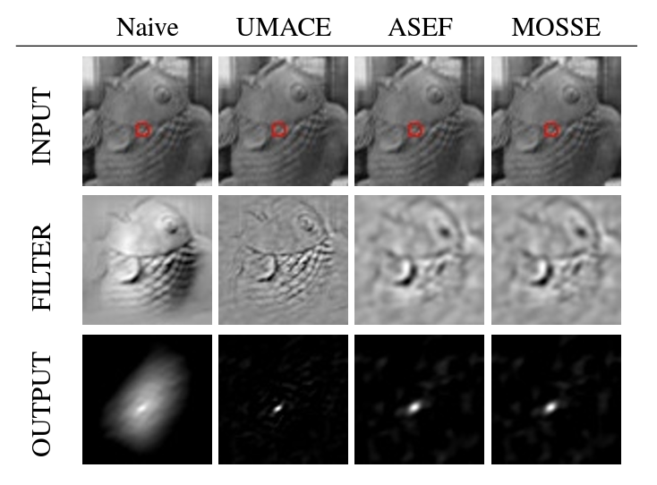
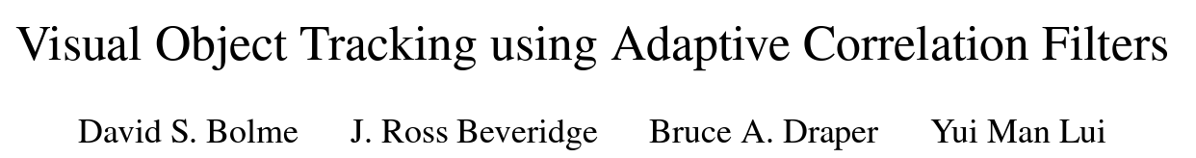
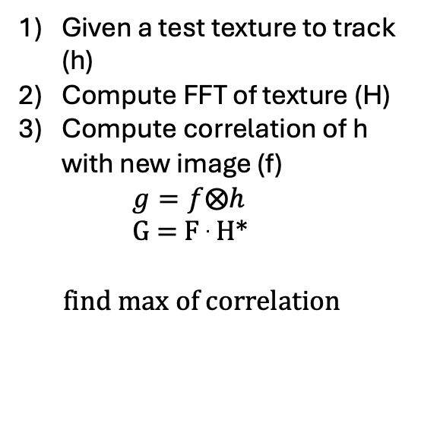
KCF (kernelized correlation function) tracker CSRT (discriminate correlation filter) MOSSE (minimum output sum of squared error
Given a test texture to track (h)
Compute FFT of texture (H)
Compute correlation of h with new image (f)
$g=f⨂h$
G = F . H*
find max of correlation

Slide 21
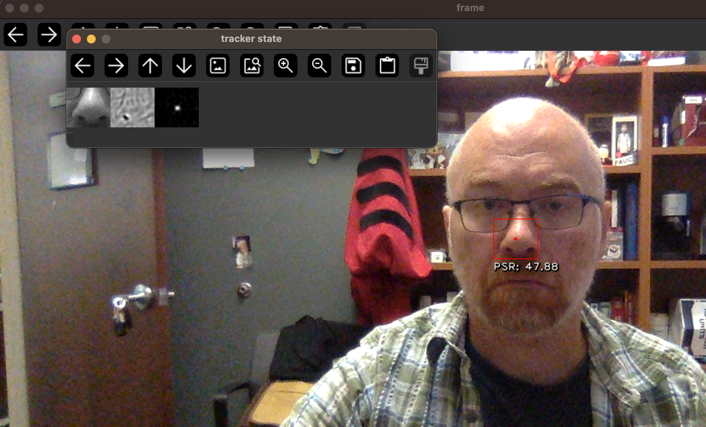

Slide 22
Lecture Notes on Kalman filters

Slide 23
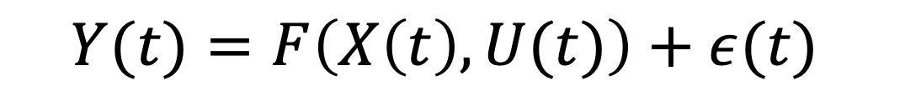
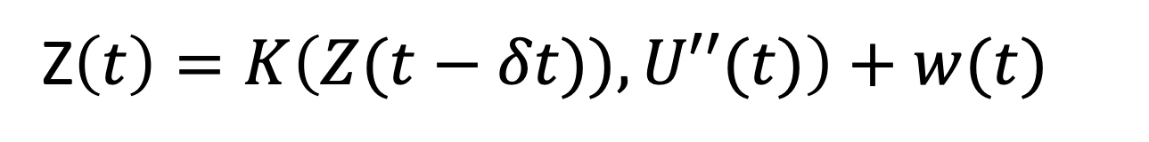
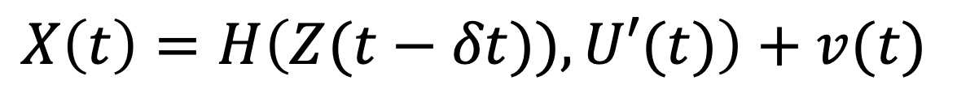
Hierarchical Noise Models
Measurement noise
Measurement (Lead field) model
Observation layer
Observations
$$Y(t)=F\left(X\left(t\right),U(t)\right)+ε(t)$$
Control/Input vector [optional]
State/process noise
Hidden-state layer I
States
$$X\left(t\right)=H\left(Z(t−δt)),U′(t)\right)+v(t)$$
State update model
Hidden-state layer II
Z$\left(t\right)=K\left(Z(t−δt)),U′′(t)\right)+w(t)$

Slide 24
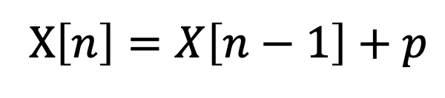
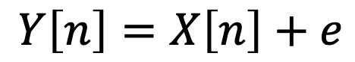
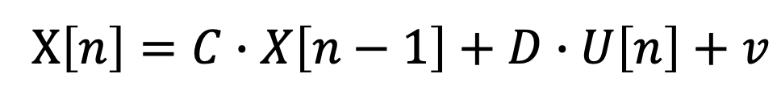
Example
Observation Layer
$\left[\begin{matrix}Y_{lat}[n] \\ Y_{long}[n]\end{matrix}\right]$= $\left[\begin{matrix}X_{lat}[n] \\ X_{long}[n]\end{matrix}\right]+ε$
Position Layer
$$\left[\begin{matrix}X_{lat}[n] \\ X_{long}[n]\end{matrix}\right]=\left[\begin{matrix}X_{lat}[n−1] \\ X_{long}[n−1]\end{matrix}\right]+p$$
$$Y\left[n\right]=X\left[n\right]+e$$
$$Y\left[n\right]=A∙X\left[n\right]+B∙U\left[n\right]+e$$
X$\left[n\right]=X\left[n−1\right]+p$
X$\left[n\right]=C∙X\left[n−1\right]+D∙U\left[n\right]+v$

Slide 25

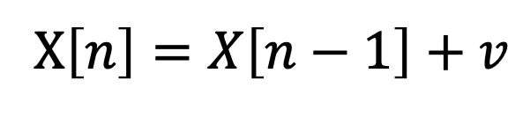
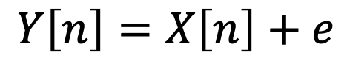
Example
Observation Layer
$$Y\left[n\right]=X\left[n\right]+e$$
$$e=N\left(0,R\right)$$
Position Layer
X$\left[n\right]=X\left[n−1\right]+v$
$$v =N(0,Q)$$

Slide 26
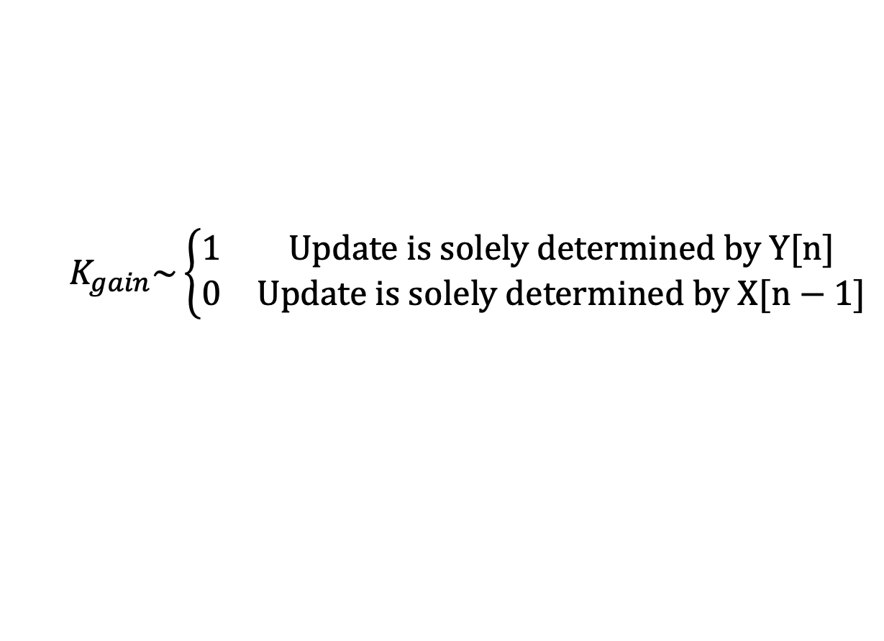
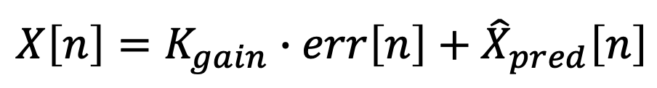
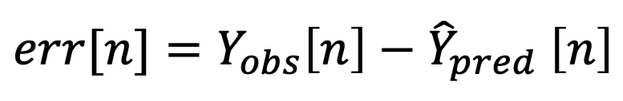

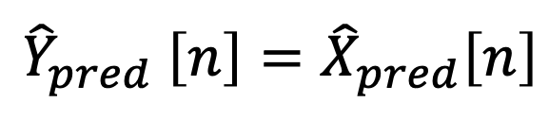
Example
Given X[n-1], where do I expect the car to be at n:
${\hat{X}}_{pred}\left[n\right]$=X[n-1]
$${\hat{Y}}_{pred} \left[n\right]={\hat{X}}_{pred}\left[n\right]$$
After I measure the position, how far off was my estimate:
$$err[n]={Y_{obs}\left[n\right]−\hat{Y}}_{pred} \left[n\right]$$
Update the estimate of X[n] between where I expected it to be and where I measured it :
$$X\left[n\right]=K_{gain}∙err\left[n\right]+{\hat{X}}_{pred}\left[n\right]$$
$$K_{gain}\sim \left\{\begin{matrix}1 & Update is solely determined by Y[n] \\ 0 & Update is solely determined by X[n−1]\end{matrix}\right.$$

Slide 27
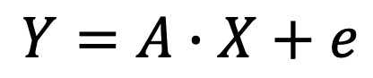

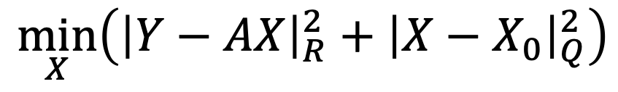
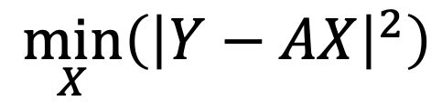
Kalman Gain
$$Y=A∙X+e$$
Least-squares
$$\min_{X}\left({\left|Y−AX\right|}^{2}\right)$$
Prior expectation of X
Weighted Least-squares
$$\min_{X}\left({\left|Y−AX\right|}_{R}^{2}+{\left|X−X_{0}\right|}_{Q}^{2}\right)$$
Notation denotes:
$${|Ψ|}_{Ω}^{2}≡Ψ∙Ω^{−1}∙Ψ^{T}$$

Slide 28
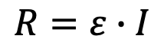
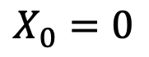
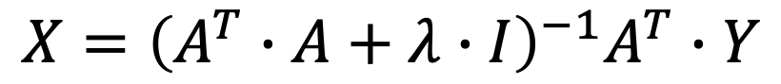
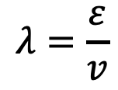
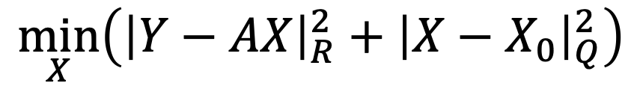

Kalman Gain
$$Y=A∙X+e$$
$$\min_{X}\left({\left|Y−AX\right|}_{R}^{2}+{\left|X−X_{0}\right|}_{Q}^{2}\right)$$
$$X={\left(A^{T}∙R^{−1}∙A+Q^{−1}\right)}^{−1}A^{T}∙R^{−1}∙\left(Y−A∙X_{0}\right)+X_{0}$$
Special Case (Tikhonov regularization/ Ridge regression)
$$R=ε∙I$$
$$λ=\frac{ε}{v}$$
$$X_{0}=0$$
← 1/Signal-to-noise ratio
Q$=v∙I$
$$X={\left(A^{T}∙A+λ∙I\right)}^{−1}A^{T}∙Y$$

Slide 29
Kalman Gain
$$Y=A∙X+e$$
$$\min_{X}\left({\left|Y−AX\right|}_{R}^{2}+{\left|X−X_{0}\right|}_{Q}^{2}\right)$$
$$X={\left(A^{T}∙R^{−1}∙A+Q^{−1}\right)}^{−1}A^{T}∙R^{−1}∙\left(Y−A∙X_{0}\right)+X_{0}$$
$$X\left[n\right]=K_{gain}∙({Y_{obs}\left[n\right]−\hat{Y}}_{pred} \left[n\right])+{\hat{X}}_{pred}\left[n\right]$$
$$X={Q∙A^{T}∙\left(A∙Q∙A^{T}+R\right)}^{−1}∙\left(Y−A∙X_{0}\right)+X_{0}$$

Slide 30








$$Y\left[n\right]=X\left[n\right]+e$$
X$\left[n\right]=X\left[n−1\right]+v$
${\hat{X}}_{pred}\left[n\right]$=X[n-1]
$${\hat{Y}}_{pred} \left[n\right]={\hat{X}}_{pred}\left[n\right]$$
Prediction
$${\hat{P}}_{pred} \left[n\right]=P\left[n\right]+Q$$
$$err[n]={Y_{obs}\left[n\right]−\hat{Y}}_{pred} \left[n\right]$$
$$S\left[n\right]={\hat{P}}_{pred} \left[n\right]+R$$
Update
$K_{gain}$= ${\hat{P}}_{pred} \left[n\right]∙{S\left[n\right]}^{−1}$
$$X\left[n\right]=K_{gain}∙err\left[n\right]+{\hat{X}}_{pred}\left[n\right]$$
Correction
$P\left[n\right]$=$\left(I−K_{gain}\right)∙{\hat{P}}_{pred} \left[n\right]$

Slide 31
$$Y\left[n\right]=A∙X\left[n\right]+B∙U\left[n\right]+e$$
X$\left[n\right]=C∙X\left[n−1\right]+D∙U\left[n\right]+v$
${\hat{X}}_{pred}\left[n\right]$=C $∙$X[n-1]+ $D∙U\left[n\right]$
$${\hat{Y}}_{pred} \left[n\right]=A∙{\hat{X}}_{pred}\left[n\right]+B∙U\left[n\right]$$
Prediction
$${\hat{P}}_{pred} \left[n\right]=C∙P\left[n\right]∙C^{T}+Q$$
$$err[n]={Y_{obs}\left[n\right]−\hat{Y}}_{pred} \left[n\right]$$
$$S\left[n\right]={A∙\hat{P}}_{pred} \left[n\right]∙A^{T}+R$$
Update
$K_{gain}$= ${\hat{P}}_{pred} \left[n\right]∙{A^{T}∙S\left[n\right]}^{−1}$
$$X\left[n\right]=K_{gain}∙err\left[n\right]+{\hat{X}}_{pred}\left[n\right]$$
Correction
$P\left[n\right]$=$\left(I−K_{gain}∙A\right)∙{\hat{P}}_{pred} \left[n\right]$

Slide 32
>> A=eye(2);
>> nk=1000;
>> xtrue = [[1:nk]./200.*sin([1:nk]/50);...
[1:nk]./200.*cos([1:nk]/50)];
>> y=A*xtrue+randn(2,nk)/3;
R=.1*eye(2);
Q=.2*eye(2);
x=zeros(2,nk);
P=eye(2);
for k=2:nk
xhat=C*x(:,k-1);
yhat = A*xhat;
Phat = C*P*C'+Q;
err = y(:,k)-yhat;
S = A*Phat*A'+R;
K = Phat*A'*inv(S);
x(:,k)=xhat+K*err;
P=(eye(2)-K*A)*Phat;
end

Slide 33
>> A=eye(2);
>> nk=1000;
>> xtrue = [[1:nk]./200.*sin([1:nk]/50);...
[1:nk]./200.*cos([1:nk]/50)];
>> y=A*xtrue+randn(2,nk)/3;
R=.1*eye(2);
Q=.2*eye(2);
x=zeros(2,nk);
P=eye(2);
for k=2:nk
xhat=C*x(:,k-1);
yhat = A*xhat;
Phat = C*P*C'+Q;
err = y(:,k)-yhat;
S = A*Phat*A'+R;
K = Phat*A'*inv(S);
x(:,k)=xhat+K*err;
P=(eye(2)-K*A)*Phat;
end

Slide 34
>> A=eye(2);
>> nk=1000;
>> xtrue = [[1:nk]./200.*sin([1:nk]/50);...
[1:nk]./200.*cos([1:nk]/50)];
>> y=A*xtrue+randn(2,nk)/3;
R=2*eye(2);
Q=.2*eye(2);
x=zeros(2,nk);
P=eye(2);
for k=2:nk
xhat=C*x(:,k-1);
yhat = A*xhat;
Phat = C*P*C'+Q;
err = y(:,k)-yhat;
S = A*Phat*A'+R;
K = Phat*A'*inv(S);
x(:,k)=xhat+K*err;
P=(eye(2)-K*A)*Phat;
end

Slide 35
>> A=eye(2);
>> nk=1000;
>> xtrue = [[1:nk]./200.*sin([1:nk]/50);...
[1:nk]./200.*cos([1:nk]/50)];
>> y=A*xtrue+randn(2,nk)/3;
R=20*eye(2);
Q=.2*eye(2);
x=zeros(2,nk);
P=eye(2);
for k=2:nk
xhat=C*x(:,k-1);
yhat = A*xhat;
Phat = C*P*C'+Q;
err = y(:,k)-yhat;
S = A*Phat*A'+R;
K = Phat*A'*inv(S);
x(:,k)=xhat+K*err;
P=(eye(2)-K*A)*Phat;
end

Slide 36












Fixed Interval Smoother
For (k=0; k<n; k++):
For (k=n; k>0; k--):
${\hat{X}}_{k|k−1}$=C $∙X_{k−1|k−1}$+ $D∙U_{k}$
$$M_{k}=P_{k|k}∙A∙{{\hat{P}}_{k+1|k}}^{−1}$$
$${\hat{Y}}_{k} =A∙{\hat{X}}_{k|k−1}+B∙U_{k}$$
$X_{k|n}=$ $X_{k|k}$ + $M_{k} ∙(X_{k+1|n}$ - $X_{k+1|k}$)
$${\hat{P}}_{k|k−1}=C∙P_{k−1|k−1}∙C^{T}+Q$$
$P_{k|n}$= $P_{k|k}+M_{k} ∙(P_{k+1|n}\text{ − }{\hat{P}}_{k+1|k}\text{)}$
$${inn}_{k}={Y_{k}−\hat{Y}}_{k}$$
end
$$S=A∙{\hat{P}}_{k|k−1}∙A^{T}+R$$
$K$= ${\hat{P}}_{k|k−1}∙{A^{T}∙S}^{−1}$
Requires storing the
$X_{k|k}$, $X_{k+1|k}$, $P_{k|k}$, and ${\hat{P}}_{k+1|k}$ from the forward pass
$$X_{k|k}=K∙{inn}_{k}+{\hat{X}}_{k|k−1}$$
$P_{k|k}$=$\left(I−K∙A\right)∙{\hat{P}}_{k|k−1}$
end

Slide 38
Tuning R and Q
R- Measurement noise
Uncertainty in each measurement
Low R → model will simply track the measurements (no filtering)
High Q → model will be independent of the data
Data fusion (use R to weight different measurements)
Q- Process noise
Allowed changes in the state between updates
Low Q → state will be more static
High Q → allows state to vary wildly (less informative)
Ideally Q is the variance(diff(state))

Slide 39
Example
Observation Layer
$\left[\begin{matrix}Y_{lat}[n] \\ Y_{long}[n]\end{matrix}\right]$= $\left[\begin{matrix}X_{lat}[n] \\ X_{long}[n]\end{matrix}\right]+ε$
Position Layer
$\left[\begin{matrix}X_{lat}[n] \\ X_{long}[n]\end{matrix}\right]=\left[\begin{matrix}X_{lat}[n−1] \\ X_{long}[n−1]\end{matrix}\right]$+$T∙\left[\begin{matrix}\cos\left(θ\left[n\right]\right) \\ −\sin\left(θ\left[n\right]\right)\end{matrix}\right]∙V_{elocity}\left[n\right]+p$
Velocity Layer
$\left[\begin{matrix}V_{elocity}\left[n\right] \\ θ[n]\end{matrix}\right]=\left[\begin{matrix}V_{elocity} [n−1] \\ θ[n−1]\end{matrix}\right]$+ $T∙ \left[\begin{matrix}A_{cc}[n] \\ W_{acc}[n]\end{matrix}\right]+v$
Acceleration Layer
$$\left[\begin{matrix}A_{cc}[n] \\ W_{acc}[n]\end{matrix}\right]=\left[\begin{matrix}A_{cc}[n−1] \\ W_{acc}[n−1]\end{matrix}\right]+ω$$

Slide 40



Example
$Y$=$\left[\begin{matrix}1 & 0 & 0 & 0 & 0 & 0 \\ 0 & 1 & 0 & 0 & 0 & 0\end{matrix}\right]∙\left[\begin{matrix}X_{lat} \\ X_{long} \\ X_{velocity} \\ θ_{velocity} \\ X_{accel} \\ θ_{accel}\end{matrix}\right]+ε$
$\left[\begin{matrix}X_{lat} \\ X_{long} \\ X_{velocity} \\ θ_{velocity} \\ X_{accel} \\ θ_{accel}\end{matrix}\right]=B\left(\left[\begin{matrix}X_{lat} \\ X_{long} \\ X_{velocity} \\ θ_{velocity} \\ X_{accel} \\ θ_{accel}\end{matrix}\right]\right)$+ $\left[\begin{matrix}υ_{lat} \\ υ_{long} \\ υ_{velocity} \\ υ_{velocity} \\ υ_{accel} \\ υ_{accel}\end{matrix}\right]$
$$B\left(X\right)=\left[\begin{matrix}X_{lat}+T∗\cos\left(θ_{velocity}\right)∗X_{velocity} \\ X_{long}−T∗\sin\left(θ_{velocity}\right)∗X_{velocity} \\ X_{velocity}+T∗X_{accel} \\ θ_{velocity}+T∗θ_{accel} \\ 1 \\ 1\end{matrix}\right]$$

Slide 41

Example
$Y$=$\left[\begin{matrix}1 & 0 & 0 & 0 & 0 & 0 \\ 0 & 1 & 0 & 0 & 0 & 0\end{matrix}\right]∙\left[\begin{matrix}X_{lat} \\ X_{long} \\ X_{velocity} \\ θ_{velocity} \\ X_{accel} \\ θ_{accel}\end{matrix}\right]+ε$
$\left[\begin{matrix}dX_{lat}/dt \\ {dX}_{long}/dt \\ {dX}_{velocity}/dt \\ {dθ}_{velocity}/dt \\ {dX}_{accel}/dt \\ {dθ}_{accel}/dt\end{matrix}\right] =\left[\begin{matrix}1 & 0 & T∙\cos\left(θ_{velocity}\right) & −T∙X_{velocity}∙\sin\left(θ_{velocity}\right) & 0 & 0 \\ 0 & 1 & −T∙sin\left(θ_{velocity}\right) & T∙X_{velocity}∙cos\left(θ_{velocity}\right) & 0 & 0 \\ 0 & 0 & 1 & 0 & T & 0 \\ 0 & 0 & 0 & 1 & 0 & T \\ 0 & 0 & 0 & 0 & 1 & 0 \\ 0 & 0 & 0 & 0 & 0 & 1\end{matrix}\right]∙\left[\begin{matrix}dX_{lat}/dt \\ {dX}_{long}/dt \\ {dX}_{velocity}/dt \\ {dθ}_{velocity}/dt \\ {dX}_{accel}/dt \\ {dθ}_{accel}/dt\end{matrix}\right]$+ $\left[\begin{matrix}υ_{lat} \\ υ_{long} \\ υ_{velocity} \\ υ_{velocity} \\ υ_{accel} \\ υ_{accel}\end{matrix}\right]$
Advantages-
Model is restricted by real-world physics. (e.g. instantaneous velocity changes are not possible)
More control over the sources of noise/error

Slide 42












$$Y\left[n\right]=H(X\left[n\right],U\left[n\right])+e$$
X$\left[n\right]=F(X\left[n−1\right],U\left[n\right])+v$
${\hat{X}}_{pred}\left[n\right]$=F( X[n-1],$U\left[n\right])$
$${\hat{Y}}_{pred} \left[n\right]=H({\hat{X}}_{pred}\left[n\right], U\left[n\right])$$
Prediction
$${\hat{P}}_{pred} \left[n\right]=F′∙P\left[n\right]∙{F′}^{T}+Q$$
$$F^{′}={\left.\frac{∂F}{∂X}\right|}_{{\hat{X}}_{pred}\left[n\right]}$$
$$err[n]={Y_{obs}\left[n\right]−\hat{Y}}_{pred} \left[n\right]$$
$$S\left[n\right]={H′∙\hat{P}}_{pred} \left[n\right]∙{H′}^{T}+R$$
Update
$$H^{′}={\left.\frac{∂H}{∂X}\right|}_{{\hat{Y}}_{pred} \left[n\right]}$$
$K_{gain}$= ${\hat{P}}_{pred} \left[n\right]∙{{H′}^{T}∙S\left[n\right]}^{−1}$
$$X\left[n\right]=K_{gain}∙err\left[n\right]+{\hat{X}}_{pred}\left[n\right]$$
Correction
$P\left[n\right]$=$\left(I−K_{gain}∙H′\right)∙{\hat{P}}_{pred} \left[n\right]$

